Slide 1

JRC Contribution
to the
NATO SfP Bio-Optical project
Giuseppe Zibordi and Jean-Francois Berthon
Joint Research Centre, European Commission, Ispra, Italy
Istanbul, 10-11 November 2011.

Slide 2
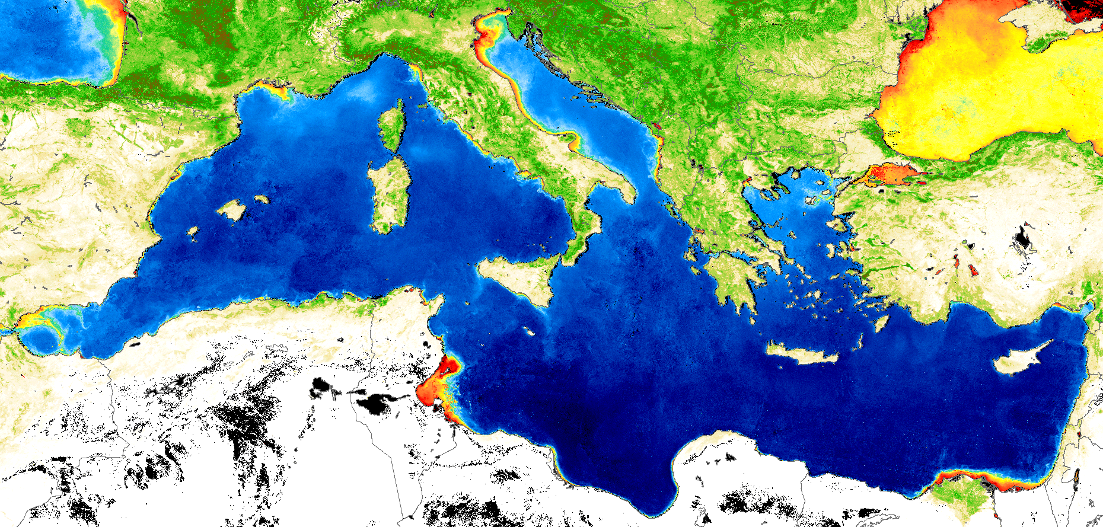
The Cal/Val Paradigm and In Situ Data
Remote Sensor
Vicarious Calibration
Remote Sensor
Pre-Launch Calibration
Data Reception
and Processing
Atmosphere
Atmosphere
In Situ Instrument
Calibration
Sea Surface
Sea Surface
Traceable
Reference
Products Development
Products Validation

Slide 3
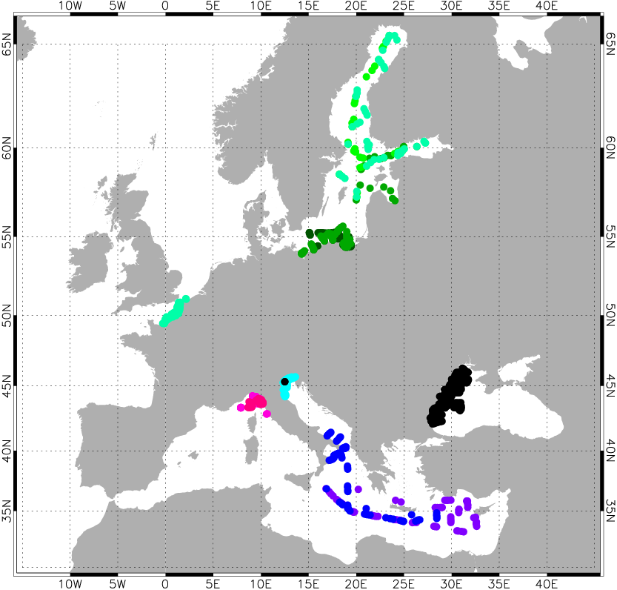






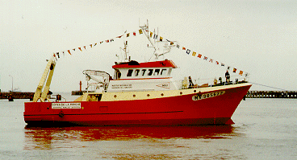
BiOMaP (Bio-Optical Marine Properties):
a European Ocean Color Development Program
BiOMaP measurements are produced applying cross-site identical and consolidated: technology, measurement and calibration protocols, processing codes and quality assurance criteria.
N=829 from 2000-2009
Baltic Proper, Gulf of Bothnia, Gulf of Finland Aug06,Aug07,Aug08
n=108
English Channel, North Sea Jun04
Southern Baltic Sea May04,Sep04,Apr05
n=55
n=170
Black Sea
Jun06,May09
BiOMaP
Ships
Adriatic Sea Jul00
n=206
Ligurian Sea Oct08,Mar09
n=55
G. Zibordi, J.-F. Berthon, F. Mélin and D. D’Alimonte. Cross-site consistent in situ measurements for satellite ocean color applications: the BiOMaP radiometric dataset. Remote Sensing of Environment,115, 2104–2115, 2011.
n=104
East.Med.Sea,Ionian Sea, S.Adr.Sea, Sep06,Apr07
n=131

Slide 4

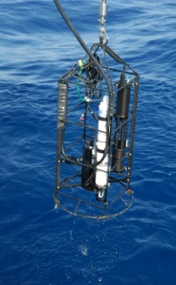
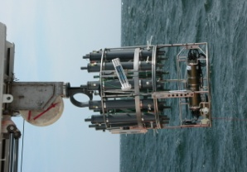

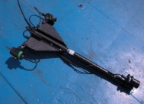
BiOMaP measurements
Field measurements
•
Profiles of
L
(z,
λ
)
,
E
(z,
λ
)
, and
E
(z,
λ
)
u
u
d
Profiles (manned)
•
Profiles of
c(z,
λ
)
and
a(z,
λ
)
(from 01/97)
•
Profiles of
b
(z,
λ
)
(from 04/00)
b
•
E
(0
+
,
λ
)
and
E
(0
+
,
λ
)
d
i
•
E
(0
+
,
λ
)
Field
Equipment
s
•
Ancillary
(
T
w
(z)
,
S
W
(z)
,
P
a
,
RH
,
T
a
,
W
s
,
W
d
,
C
,
M
)
Related laboratory analysis
from field water samples
•
Pigments (HPLC)
•
a
(
λ
)
and
a
(
λ
)
Samples (conditioned)
ph
dp
•
a
(
λ
)
ys
•
TSM
•
Ancillary (
PSD
)
(up to 10/98)

Slide 5
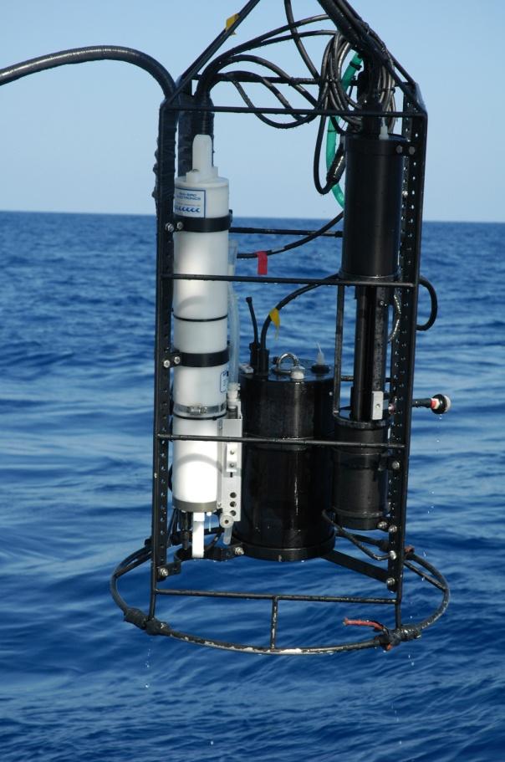
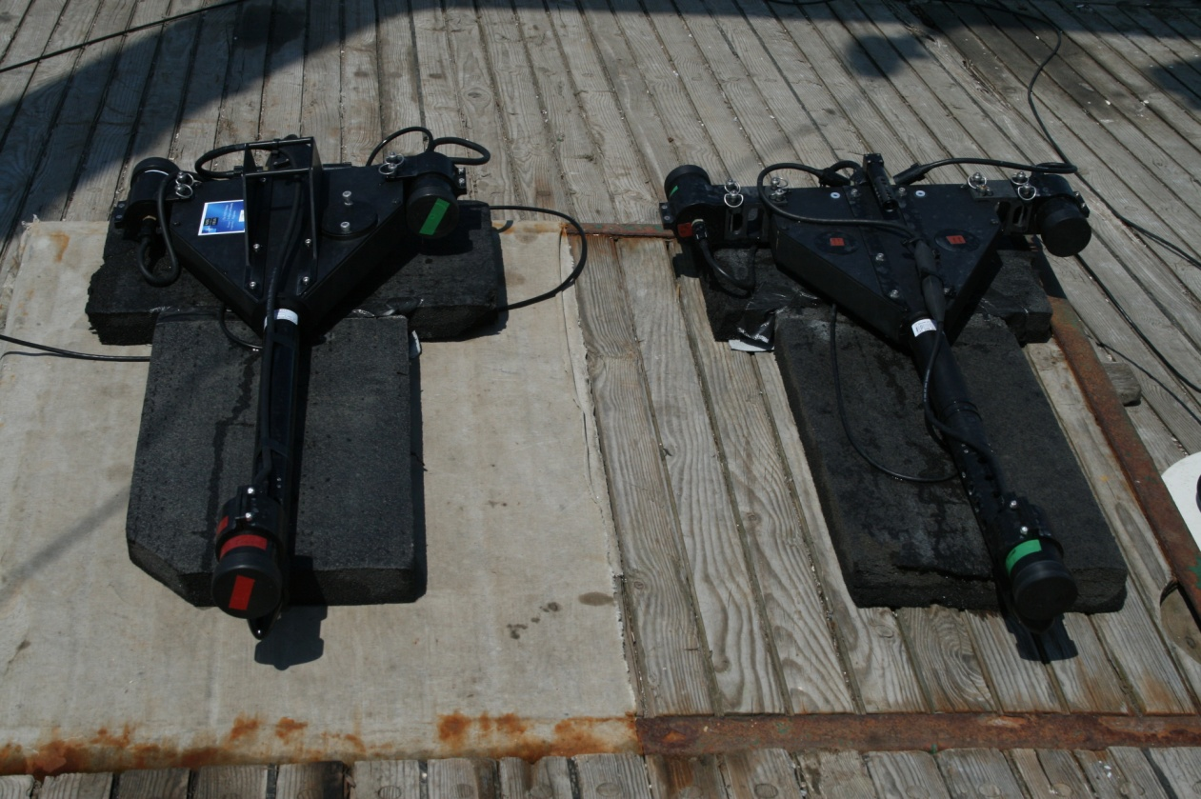
Profiling Systems

Slide 6
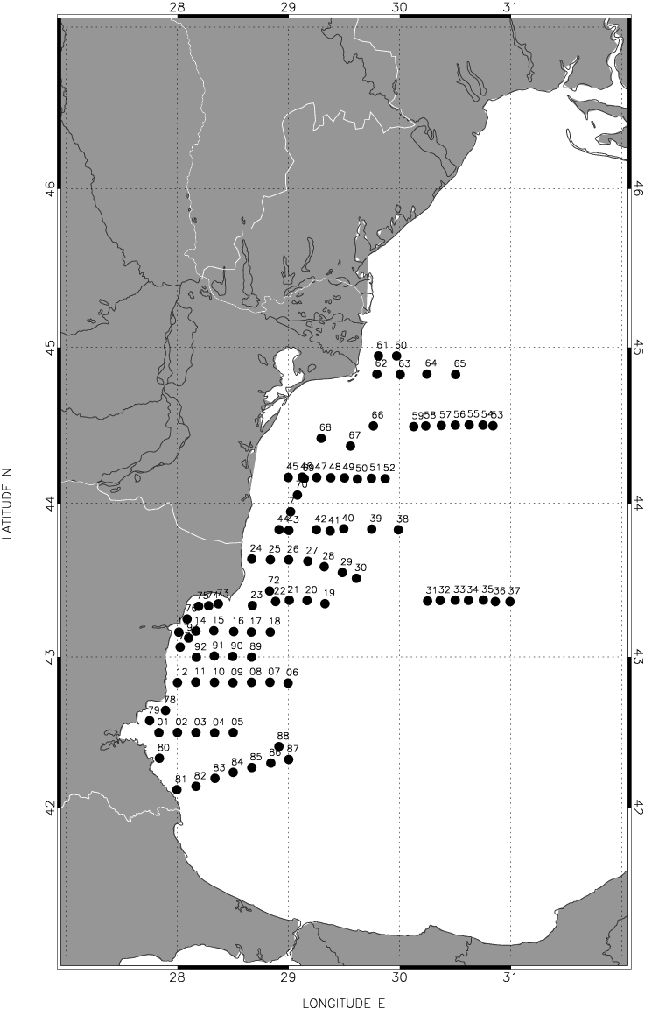
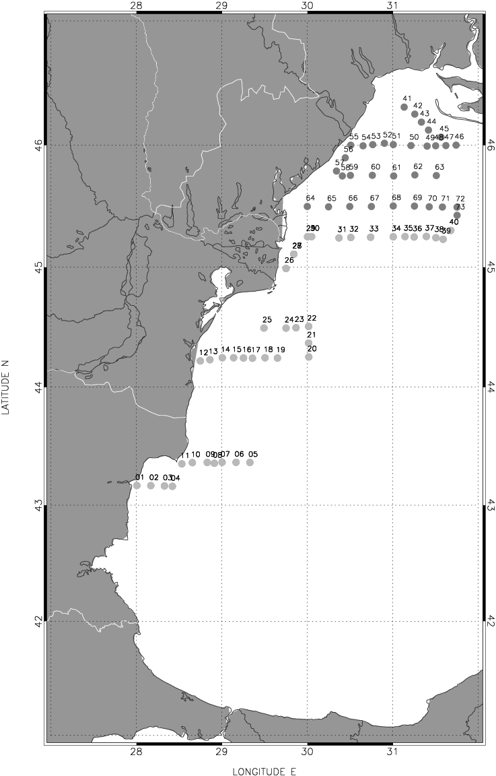
Field Campaigns in the Black Sea (1)
June 2006
May 2009

Slide 7
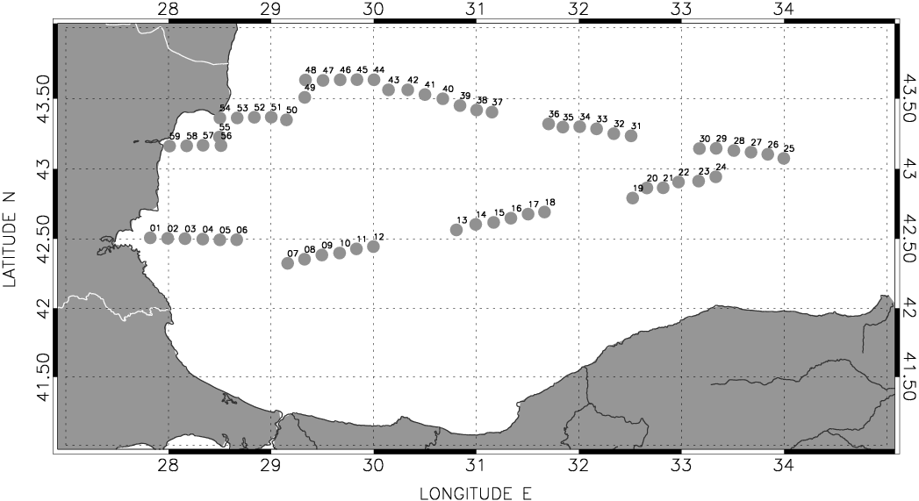
Field Campaigns in the Black Sea (2)
July 2011

Slide 8
Measurements performed by the JRC during the NATO Cruises
Quantity | Symbol | Wavelengths range or center-wav. | Instrument/Method
Remote sensing reflectance | R_{rs} | 412,443,490,510,555,670,683 nm | JRC and NATO Satlantic micro-profiler
Diffuse attenuation coefficient | K_{d} | 412,443,490,510,555,670,683 nm | JRC and NATO Satlantic micro-profiler
Total absorption coefficient | a | 412,443,490,510,555, 630, 650, 676,715 nm | JRC WetLab AC-9
Absorption coefficient of pigmented particles | a_{p} | 400-750 nm (with 1 nm resolution) | Spectrometry (JRC Perkin-Elmer Lambda 900)
Absorption coefficient of non-pigmented particles | a_{dt} | 400-750 nm (with 1 nm resolution) | Spectrometry (JRC Perkin-Elmer Lambda 900)
Absorption coefficient of colored diss. organic matter | a_{y} | 350-750 nm (with 1 nm resolution) | Spectrometry (JRC Perkin-Elmer Lambda 12)
Scattering coefficient | b | 412,443,490,510,555, 630, 650, 676,715 nm | JRC WetLab AC-9
Backscattering coefficient | b_{b} | 443,490,510,555,620, 670 nm | JRC HobiLabs Hydroscat-6
Volume scattering function | β | 443,490,510, 532, 555,590, 620 nm | MHI VSF_Meter
Pigments concentration | Chl | Includes total chlorophyll-a | HPLC
Total suspended matter | TSM |  | Filtration and weighting
Salinity and temperature | S & T | Typically down to 25-35 m | JRC and Mare Nigrum CTDs
Aerosol optical thickness | τ_{a} | 440, 490, 550, 670, 870 nm | JRC and NATO Sun-photometers
Fluorescence | Fl | Includes chlorophyll a and colored dissolved organic matter fluorescence | SIO Fluorometer

